Slide 1
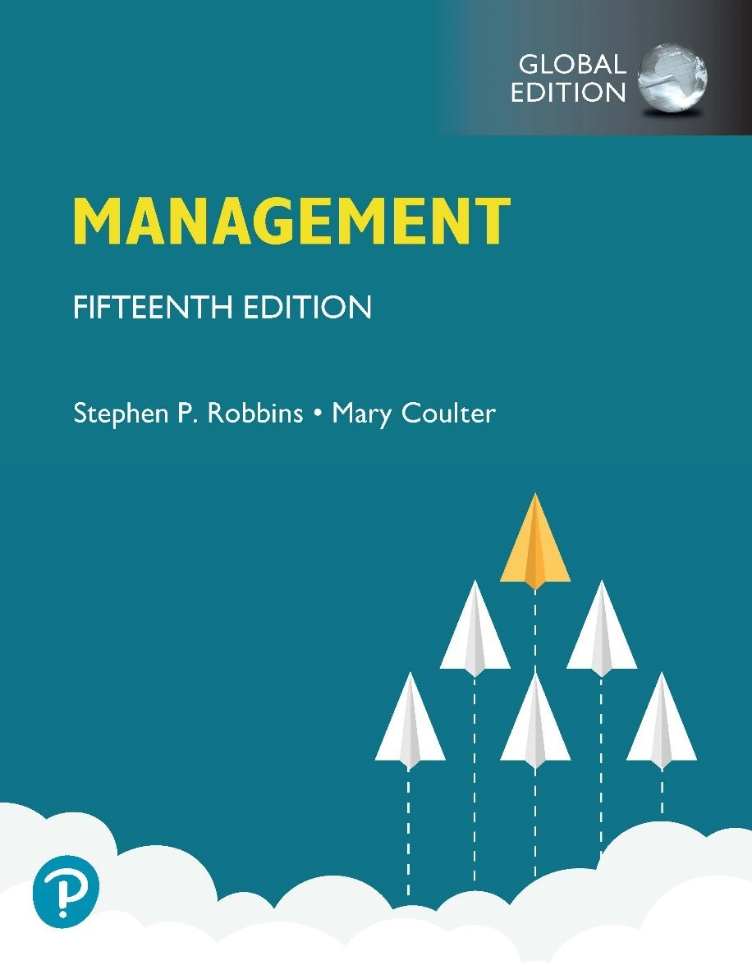
Management
Fifteenth Edition, Global Edition
Chapter 10
Entrepreneurial Ventures

Slide 2

Entrepreneurial Ventures

Slide 3



Entrepreneurial Ventures

Slide 4
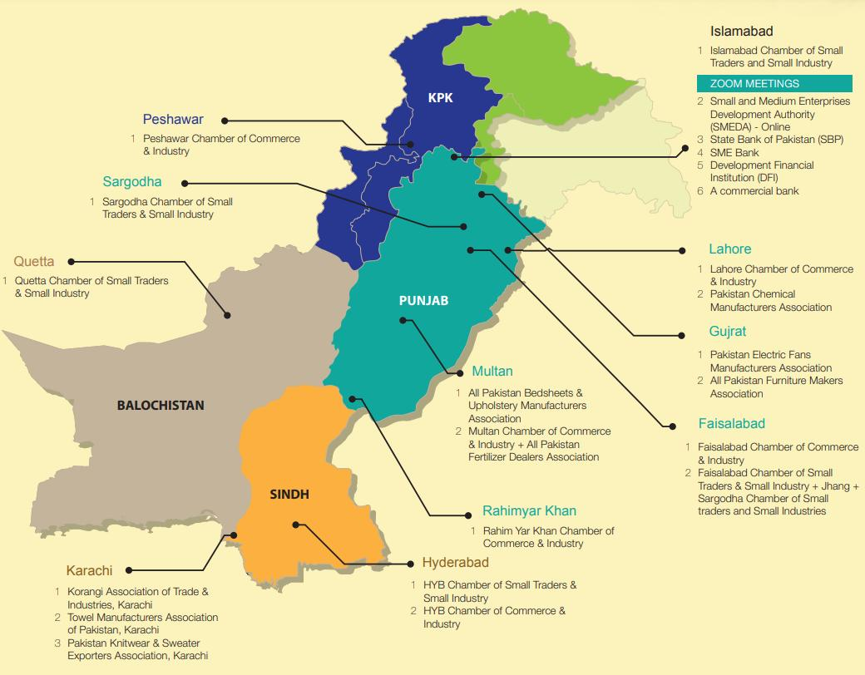

Slide 5
Learning Objectives
Define entrepreneurship and explain why it’s important.
Explain what entrepreneurs do in the planning process for new ventures.
Describe the six legal forms of organization and the choice of appropriate organizational structure.
Describe how entrepreneurs lead organizations.
Explain how managers control organizations and exit the venture.

Slide 6
What is Entrepreneurship?
Entrepreneurship: the process of starting new businesses, generally in response to opportunities
Entrepreneurial ventures: organizations that pursue opportunities, are characterized by innovative practices, and have growth and profitability as their main goals

Slide 7

Class Discussion??? Would this Work?
“An AI-powered AgriTech startup in Peshawar helping farmers improve productivity, access markets, and increase income through digital technology.”

Slide 8


Class Discussion??? Would this Work?
Traditional Handicraft E-Commerce Brand Ideas
An online platform selling:
Peshawari chappals
Handcrafted shawls
Carpets
Traditional caps
Tribal artwork

Slide 9
Small Business Versus Entrepreneurship
A small business is an organization that is independently owned, operated, and financed.
Small business owners see risk where entrepreneurs see opportunity.
Entrepreneurs want to change the world and have a passion that goes beyond profits.
Small business owners want to make a living.

Slide 10
Entrepreneurship Versus Self-Employment?
Self-employment: individuals who work for profit or fees in their own business, profession, trade, or farm.

Slide 11
Small Business Versus Entrepreneurship
Example: Local Shoe Shop vs Online Footwear Startup
Small Business Example
Local Shoe Shop in Peshawar
Sells shoes in one local market
Limited customers
Traditional selling method
Goal is stable monthly income
Characteristics
Small investment
Limited expansion
Local operations only

Slide 12
Why is Entrepreneurship Important?
Innovation
Economic growth
Job creation
Global entrepreneurship

Slide 13
The Entrepreneurial Process
Explore the entrepreneurial context
Identify opportunities and possible competitive advantages
Start the venture
Manage the venture

Slide 14
What Do Entrepreneurs Do?
No two entrepreneurs are exactly the same. Generally, they:
Create something new and different
Search for, respond to, and exploit change
Research feasibility
Launch and manage new ventures

Slide 15
A Hybrid Path to Entrepreneurship
Over half of new-venture start-ups fail in the first four years.
One way to increase the odds of success is to keep your day job and start the venture on the side.
Lets you test ideas with less pressure to make a living.
It’s a lower risk path with higher survival rates.

Slide 16
Identifying Environmental Opportunities and Competitive Advantage
Sources of opportunity:
The unexpected
The incongruous
The process need
Industry and market structures
Demographics
Changes in perception
New knowledge

Slide 17
Researching the Venture’s Feasibility—Ideas
When exploring idea sources, entrepreneurs should look for:
Limitations of what is currently available
New and different approaches
Advances and breakthroughs
Unfilled niches
Trends and changes

Slide 18
Exhibit 10.1 Evaluating Potential Ideas
Personal Considerations Marketplace Considerations
Do you have the capabilities to do what you’ve selected?
Are you ready to be an entrepreneur?
Who are the potential customers for your idea: who, where, how many?
What similar or unique product features does your proposed idea have compared to what’s currently on the market?
Are you prepared emotionally to deal with the stresses and challenges of being an entrepreneur?
Are you prepared to deal with rejection and failure?
How and where will potential customers purchase your product?
Have you considered pricing issues and whether the price you’ll be able to charge will allow your venture to survive and prosper?
Are you ready to work hard?
Have you considered how you will need to promote and advertise your proposed entrepreneurial venture?
Do you have a realistic picture of the venture’s potential?
Have you educated yourself about financing issues?
Are you willing and prepared to do continual financial and other types of analyses?

Slide 19
Feasibility Study
Feasibility study: an analysis of the various aspects of a proposed entrepreneurial venture designed to determine its feasibility

Slide 20
Researching the Venture’s Feasibility—Competitors
Potential questions include:
What types of products or services are competitors offering?
What are their products’ strengths and weaknesses?
How do they handle marketing, pricing, and distribution?
How do they attempt to do differently from other competitors?

Slide 21
Researching the Venture’s Feasibility—Financing
Venture capitalists: external equity financing provided by professionally managed pools of investor money
Angel investors: a private investor (or group of private investors) who offers financial backing to an entrepreneurial venture in return for equity in the venture
Initial public offering (IP O): the first public registration and sale of a company’s stock

Slide 22
Developing a Business Plan
Business plan: a written document that summarizes a business opportunity and defines and articulates how the identified opportunity is to be seized and exploited

Slide 23
Business Plan—Major Areas
Executive summary
Analysis of opportunity
Analysis of the context
Description of the business
Financial data and projections
Supporting documentation

Slide 24
Legal Forms of Organization (1 of 3)
Sole proprietorship: a form of legal organization in which the owner maintains sole and complete control over the business and is personally liable for business debts
General partnership: a form of legal organization in which two or more business owners share the management and risk of the business

Slide 25
Legal Forms of Organization (2 of 3)
Limited liability partnership (LL P): a form of legal organization consisting of general partner(s) and limited liability partner(s)
Corporation: a legal business entity that is separate from its owners and managers
Closely held corporation: a corporation owned by a limited number of people who do not trade the stock publicly

Slide 26
Legal Forms of Organization (3 of 3)
S corporation: a specialized type of corporation that has the regular characteristics of a C corporation but is unique in that the owners are taxed as a partnership as long as certain criteria are met
Limited liability company (LL C): a form of legal organization that’s a hybrid between a partnership and a corporation
Operating agreement: the document that outlines the provisions governing the way an LL C will conduct business

Slide 27

Exhibit 10.2 Legal Forms of Business Ownership (1 of 3)
Structure | Ownership requireme nts | Tax treatment | Liability | Advantages | Drawbacks
Sole | One | Income and | Unlimited | Low start-up | Unlimited personal
proprietorship | owner | losses “pass | personal | costs, freedom | liability, personal
 |  | through” to | liability | from most | finances at risk,
 |  | owner and are |  | regulations, | miss out on many
 |  | taxed at |  | owner has direct | business tax
 |  | personal rate |  | control, all | deductions, total
 |  |  |  | profits go to | responsibility, may
 |  |  |  | owner, easy to | be more difficult to
 |  |  |  | exit business | raise financing
General | Two or | Income and | Unlimited | Ease of | Unlimited personal
partnership | more | losses “pass | personal | formation, | liability, divided
 | owners | through” to | liability | pooled talent, | authority and
 |  | partners and are |  | pooled | decisions, potential
 |  | taxed at |  | resources, | for conflict,
 |  | personal rate; |  | somewhat | continuity of transfer
 |  | flexibility in |  | easier access to | of ownership
 |  | profit-loss |  | financing, some
 |  | allocations to |  | tax benefits
 |  | partners

Slide 28
Exhibit 10.2 Legal Forms of Business Ownership (2 of 3)
Structure | Ownershp Tax requirements treatment |  | Liability | Advantages | Drawbacks
Limited | Two or more | Income and | Limited, | Good way to | Cost and complexity
liability | owners | losses “pass | although | acquire capital | of forming can be
partnership |  | through” to | one | from limited | high, limited partners
(LLP) |  | partners and | partner | partners | can’t manage w/o
 |  | are taxed at | must |  | losing liability
 |  | personal rate; | retain |  | protection
 |  | flexibility in | unlimited
 |  | profit-loss | liability
 |  | allocations to
 |  | partners
C | Unlimited | Dividend | Limited | Limited liability, | Expensive to set up,
Corporation | number of | income taxed |  | transferable | closely regulated,
 | shareholders, | at corporate |  | ownership, | double taxation,
 | no limits on | and personal |  | continuous | extensive record
 | types of stock | shareholder |  | existence, easier | keeping, charter
 | or voting | levels, losses |  | access to | restrictions
 | arrangement | and |  | resources
 |  | deductions
 |  | are corporate

Slide 29
Exhibit 10.2 Legal Forms of Business Ownership (3 of 3)
Structure | Ownership requirements | Tax treatment | Liability | Advantages | Drawbacks
S corporation | Up to 75 shareholders, no limits on types of stock or voting arrangement | Income and losses “pass through” to partners and are taxed at personal rate; flexibility in profit-loss allocations to partners | Limited | Easy to set up, limited liability and tax benefits of partnership, can have tax-exempt entity as shareholder | Must meet certain requirements, may limit future financing options
Limited liability company (LLC) | Unlimited number of “members,” flexible membership arrangements for voting rights and income | Income and losses “pass through” to partners and are taxed at personal rate; flexibility in profit-loss allocations to partners | Limited | Greater flexibility, not constrained by regulations on C and S corporations, taxed as partnership not corporation | Cost of switching from one form to this can be high, need legal and financial advice in forming operation agreement

Slide 30
Organizational Design and Structure
Organizational design decisions in entrepreneurial decisions revolve around six key elements:
work specialization
departmentalization
chain of command
span of control
amount of centralization/decentralization
amount of formalization

Slide 31
Human Resource Management
Employee recruitment
Employee retention

Slide 32
Personality Characteristics of Entrepreneurs
Proactive personality: a personality trait that describes individuals who are more prone to take actions to influence their environments

Slide 33
Motivating Employees Through Empowerment
Employee empowerment—giving employees the power to make decisions and take actions on their own to solve problems—is an important motivational approach.

Slide 34
The Entrepreneur as Leader
Leading the venture
Leading employee work teams

Slide 35
Exhibit 10.3 Strengths of Entrepreneurs
Risk: Can manage high-risk situations; mitigating risk rather than seeking it
Knowledge: Strives to acquire in-depth information about the industry
Independence: Can manage every aspect of his/her organization Confidence: Believes in oneself and his/her ability to succeed Delegation: Unafraid to assign tasks to others
Determination: Strong work ethic; undeterred by failure
Relationships: Able to build mutually beneficial relationships
Selling: Speaks boldly on behalf of the organization; can influence others
Profitability: Sets clear goals; measures progress; good judge of opportunities
Disruption: Constantly has new ideas for products and services

Slide 36
Venture Stages and Leadership Needs
Start-up stage: The entrepreneur is the heart and soul of the business. The firm is informal, flexible, and ambiguous.
Transition stage: The venture moves from an informal organization to one that is more structured. The entrepreneur must learn to delegate in this stage.
Scaling stage: The uniqueness of entrepreneurship is gone, and the concepts of management become generalizable.

Slide 37
Potential Control Problems and Actions
Entrepreneurs need to develop controls in these areas:
Keep a close eye on the numbers: Monitor expenses, cash flow, inventory, etc.
Monitor the competition: Competitive intelligence is key to long-term success.
Maintain regular contact with customers: Make sure your customers are still satisfied with your product.
Monitor employee performance: Are employees continuing to work as expected. Do they need training?
Monitor employee workloads: Are key people trying to do too much?

Slide 38
Exiting the Venture
Harvesting: exiting a venture when an entrepreneur hopes to capitalize financially on the investment in the venture

Slide 39
Five Exit Options
Merger or acquisition
Selling to a friendly buyer
Initiate an IP O
Treat it as a cash cow
Liquidation

Slide 40
Business Valuation Methods
Asset valuations
Earnings valuations
Cash-flow valuations

Slide 41
Review Learning Objective 10.1
Define entrepreneurship and explain why it’s important.
Entrepreneurial ventures are characterized by innovative practices and have growth and profitability as their main goals
Entrepreneurship is important because it brings forward innovative ideas, creates new start-up firms, and creates jobs.

Slide 42
Review Learning Objective 10.2
Explain what entrepreneurs do in the planning process for new ventures.
Entrepreneurs must identify environmental opportunities and competitive advantage
They must research a venture’s feasibility, first generating and then evaluating ideas
Feasibility study
Business plan

Slide 43
Review Learning Objective 10.3
Describe the six legal forms of organization and the choice of appropriate organizational structure.
Two primary factors that affect the decision about how to organize a business are taxes and legal liability:
Sole proprietorship
General partnership
Limited liability partnership (LL P)
Corporation
S corporation
Limited liability corporation (LL C)

Slide 44
Review Learning Objective 10.4
Describe how entrepreneurs lead organizations.
Personality traits:
High level of motivation
Abundance of self-confidence
Ability to be involved for the long term
High energy level
Proactive personality trait

Slide 45
Review Learning Objective 10.5
Explain how managers control organizations and exit the venture.
Managing growth:
Planning for growth
Organizing for growth
Controlling growth
Managing downturns
Exiting the venture:
Harvesting
Valuation methods

Slide 46
Conclusion ….
Despite economic and structural challenges, Pakistan has strong entrepreneurial potential due to its youth population, growing digital economy, and industrial capabilities.

Slide 47

Digital Pakistan is our Goal.

